Slide 1

WELCOME TO
PROJECT
COLLEGE SCHEDULE

Slide 2

PRESENTATION BOOK

Slide 3

T
AGENTA…..
Disadvantage…
Motive of Project…
Lack of Time
Man Power
Investigation
Teacher’s Approval
Time Management
Less Time
Single person is sufficient
Less Investigation
Teacher’s Approval
Easy to change schedule in a fraction of second
PAGE 01
PAGE 02

Slide 4



http://www.collegeschedule.com
Google Search
I’m feeling lucky

Slide 5

…COLLEGE SCHEDULE...
Add Teacher
New Schedule
NAME | SUBJECT DETAIL | UPDATE / DELETE
Prof. U.k Das | CNS{ 7th Sem, CSE} FLAT{ 5th Sem, CSE}
Prof. S.S Tripathy | SPM{ 7th Sem, CSE} DBMS{ 5th Sem, CSE} MATH III{ 3rd Sem, CSE}
Prof. S.K Balabantaray | IPR{ 7th Sem, CSE} OS{ 5th Sem, CSE}
Prof. P Sahu | IMF{ 7th Sem, CSE} EE{ 3rd Sem, CSE}
Prof. N Tripathy | CG{ 5th Sem, CSE} DS{ 3rd Sem, CSE}
Prof. S Pattanaik | ED{ 7th Sem, CSE} OOPS using java { 3rd Sem, CSE}
Edit
Delete
Edit
Delete
Edit
Delete
Edit
Delete
Edit
Delete
Edit
Delete

Slide 6

ADD TEACHER
Enter Name
Courses
---select---
Select Branch
Select Semester
Select Subject
---select---
---select---
---select---
Save
Close

Slide 7
…COLLEGE SCHEDULE...
Add Teacher
New Schedule
NAME | SUBJECT DETAIL | UPDATE / DELETE
Prof. U.k Das | CNS{ 7th Sem, CSE} FLAT{ 5th Sem, CSE}
Prof. S.S Tripathy | SPM{ 7th Sem, CSE} DBMS{ 5th Sem, CSE} MATH III{ 3rd Sem, CSE}
Prof. S.K Balabantaray | IPR{ 7th Sem, CSE} OS{ 5th Sem, CSE}
Prof. P Sahu | IMF{ 7th Sem, CSE} EE{ 3rd Sem, CSE}
Prof. N Tripathy | CG{ 5th Sem, CSE} DS{ 3rd Sem, CSE}
Prof. S Pattanaik | ED{ 7th Sem, CSE} OOPS using java { 3rd Sem, CSE}
Edit
Delete
Edit
Delete
Edit
Delete
Edit
Delete
Edit
Delete
Edit
Delete

Slide 8
Basic Information
Select Branch
Select Semester
CSE
5th
Class Start Time
Class End Time
8.00 AM
3.00 PM
Select Launch Time
12.00 PM
Class Duration
Number Of Classes
60 Minute
7
Create
Close

Slide 9

TIME TABLE
DAY
8:00-9:00
9:00-10:00
10:00-11:00
11:00-12:00
12:00-1:00
1:00-2:00
2:00-3:00
MONDAY
ES
MATH III
Oops using java
Launch
DS
EE
DLD
TUESDAY
DLD
EE
Oops using java
ES
MATH III
DS
Launch
WEDNESDAY
Oops using java
DLD
ES
MATH III
Launch
DS
EE
THURSDAY
DS
ES
MATH III
DLD
Launch
Oops using java
EE
FRIDAY
MATH III
DLD
Oops using java
Launch
ES
DS
EE
SATURDAY
Oops using java
DLD
DS
EE
Launch
MATH III
ES

Slide 10
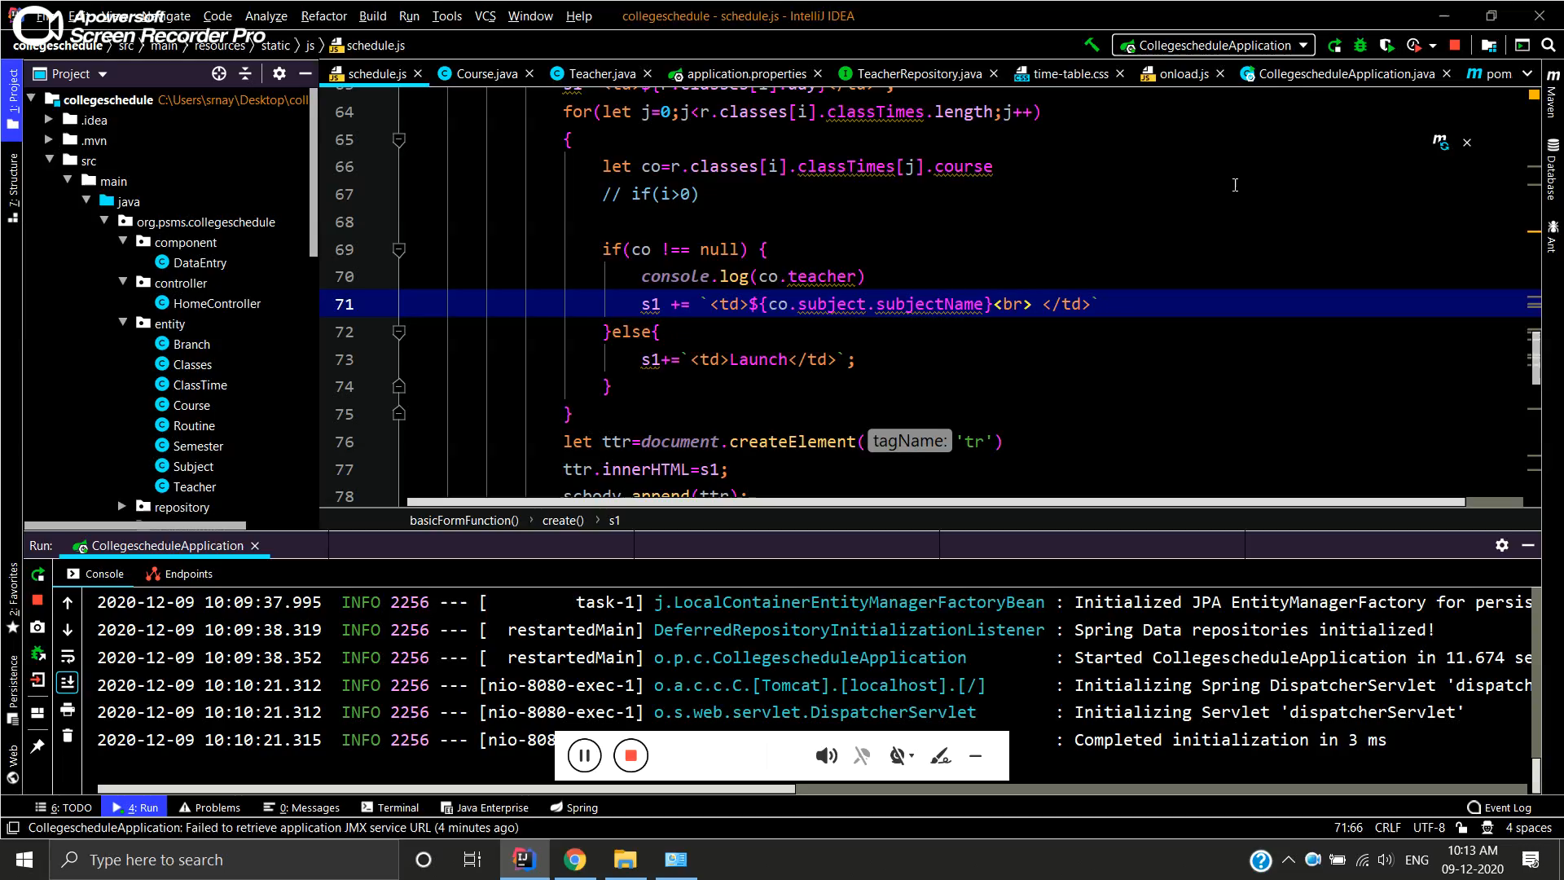
OVERAL VIEW OF PROJECT

Slide 11
What is Database Relationship??
Database relationships are associations between tables that are created using join statements to retrieve data. ... Both tables can have only one record on each side of the relationship. Each primary key value relates to none or only one record in the related table.

Slide 12
01
ONE TO ONE
Uni- Directional
BI- Directional
02
ONE TO MANY
Type Of
Relationship
( Uni- Directional )
03
MANY TO ONE
( Bi- Directional )
04
MANY TO MANY

Slide 13

CLASSES
CLASS TIME
SUBJECT
BRANCH
ROUTINE
COURSE
SEMESTER
TEACHER

Slide 14
THANK YOU

